Slide 1
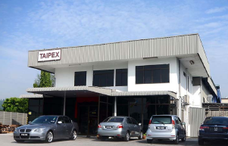
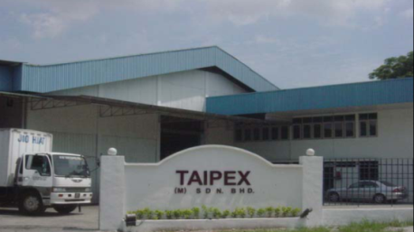

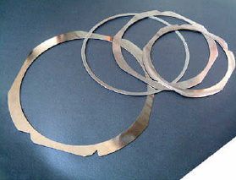
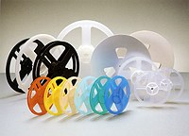

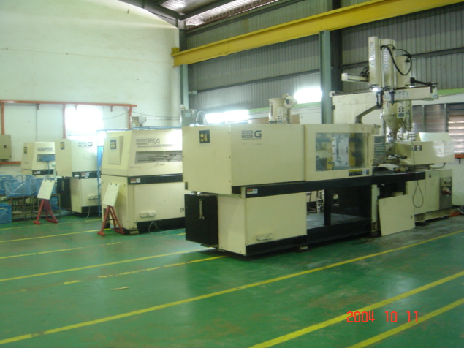
TaiPex (M) Sdn Bhd
Tape & Reel
Electronic Component Packaging Solutions
TAIPEX (M) SDN BHD

Slide 2
TAIPEX (M) SDN BHD
Company Profile
A Subsidiary company of GYC Industrial Group founded in 1999 wholly owned by Malaysian.
Headquartered in Penang, Malaysia. Sales and HQ in C1-03A-01 Setia Triangle CorporateTower Suite, Persiaran Kelicap, Sungai Ara, 11900 Bayan Lepas, Penang.
Specializing in Design and Packaging Solutions.
Designing, manufacturing and sourcing of highly engineered products.
Authorized and Paid up capital : RM2,900,000.00.
Factory (ISO9001 : 2015 Certified and target ISO14001 Certification by Q2 2024).
-- P1 : Bayan Lepas Industrial Area (Injection Mold). Built up area of 25,000 sq ft equipped
with 23 high end injection mold machines with total build capacity of 23 million shots per annum.
-- P2 : Senawang Industrial Estate (Warehouse, Assembly & QA Support). Built up area of 8,000 sq ft.
Products are all in compliance to ROHS requirements for Lead, Cadmium, Mercury, Chromium VI, PBB , PBDE & Halogen. SGS lab certified.

Slide 3
TAIPEX (M) SDN BHD

Slide 4
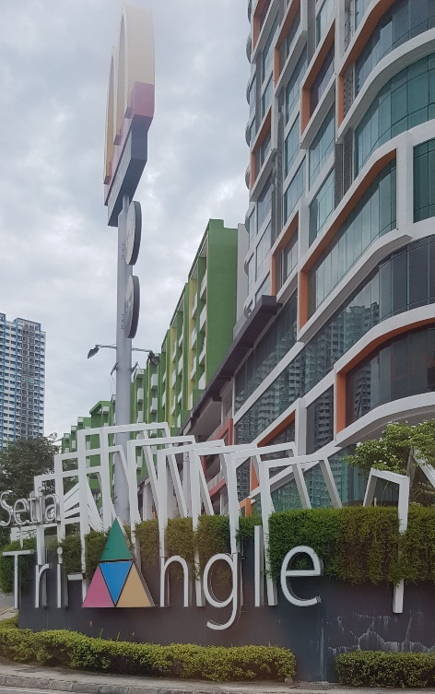
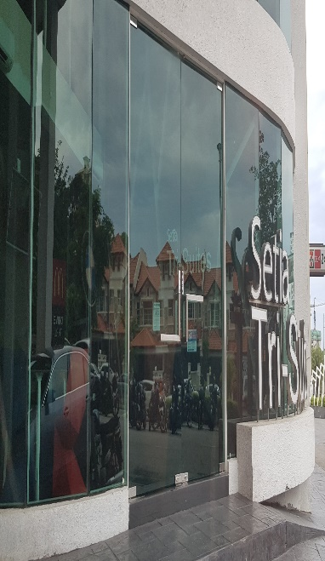
TAIPEX (M) SDN BHD
Corporate Operating Principles
Management
Flat & Lean Organization
Close rapport with workers
High emphasis on employee welfare
Humility & Low Profile
Operation
Plastic base
Manufacturing : Injection molding, Thermoforming & Extrusion
Environmental friendly
Sales & Logistic System
Focus on SEA region with local warehousing option available
Focused marketing force with strong expertise in the related field
Quick and fast response

Slide 5
Quality Policy
TaiPex (M) Sdn Bhd believes in building trust with our customers through quality (continuous quality & productivity improvement (CQPI)) in all aspect of our operations and services in order to provide optimized & value added products and services to our valued customers.
We commit to our customer’s expectation(s) and will go the extra mile to meet & exceed those expectation(s) to the best of our ability.
Benson Goh
…………………….
Benson Goh
CEO
TAIPEX (M) SDN BHD

Slide 6
Vision Statement
TaiPex (M) Sdn Bhd aims to be the Best-in-Class Supplier of highly engineered packaging products.
Benson Goh
…………………….
Benson Goh
CEO
TAIPEX (M) SDN BHD

Slide 7
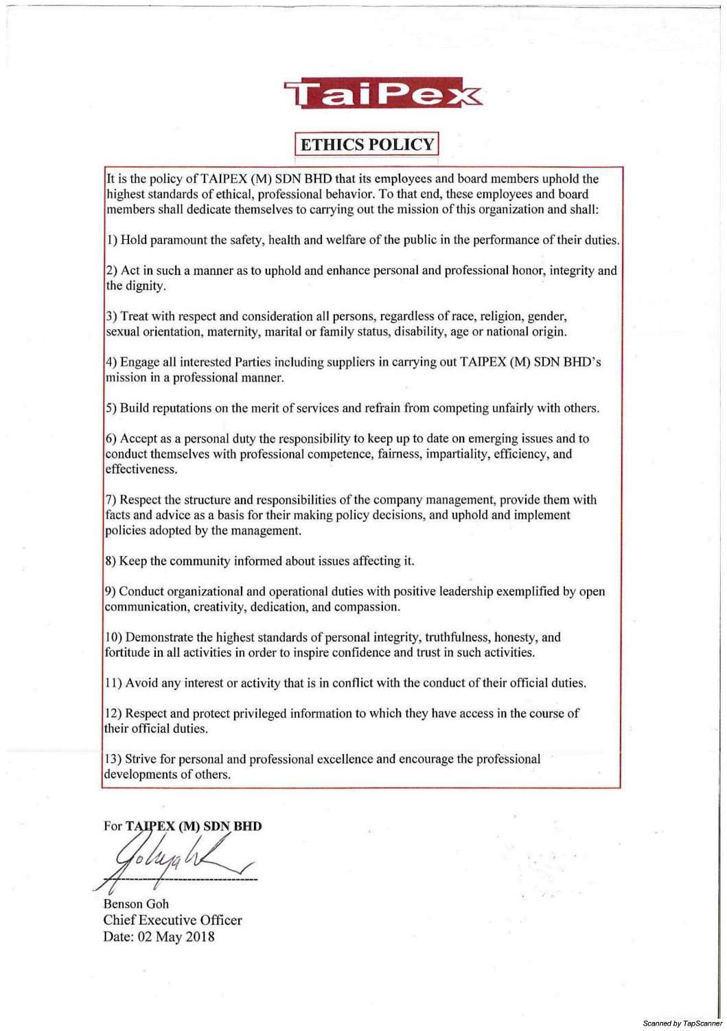

Slide 8
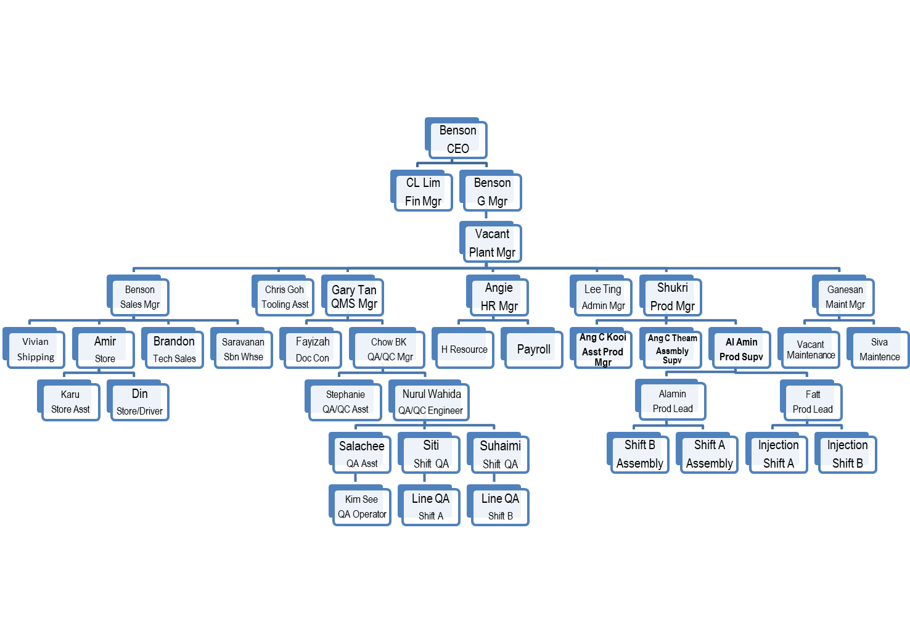
Penang Facility Organisation Chart
TAIPEX (M) SDN BHD

Slide 9
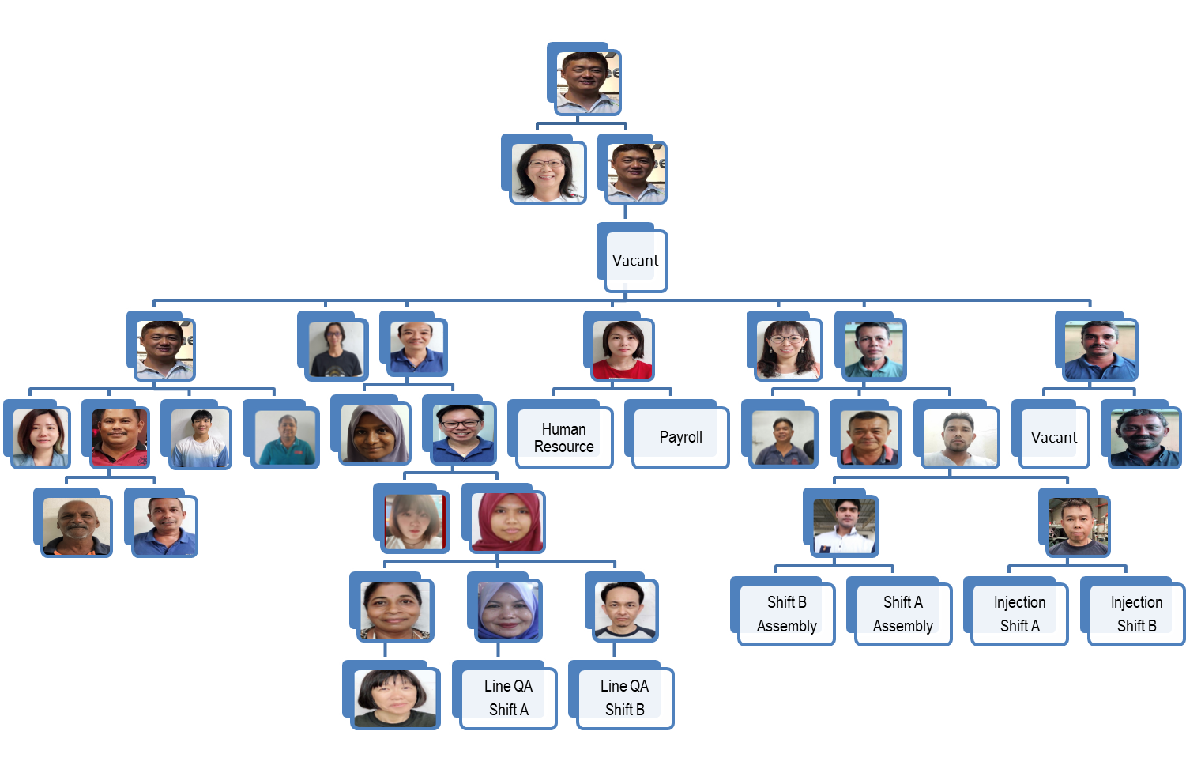
Penang Facility Organisation Chart (Photo)
TAIPEX (M) SDN BHD

Slide 10
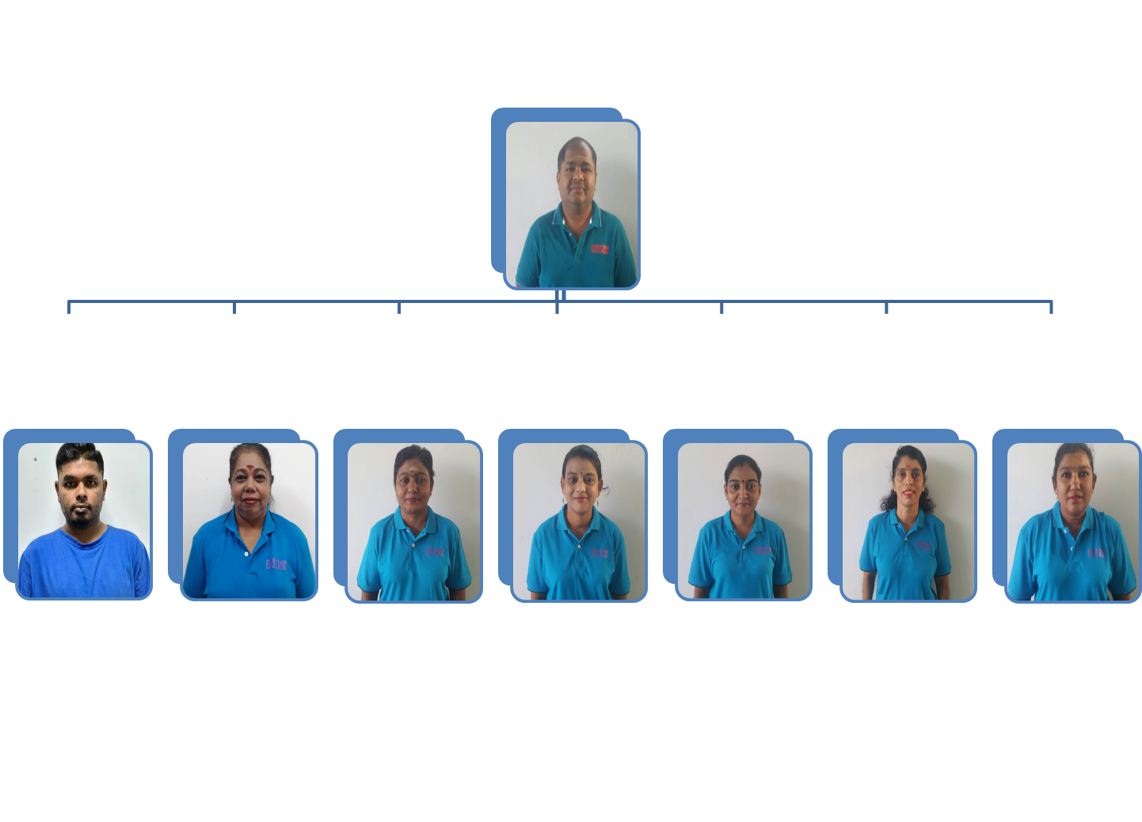
Seremban Warehouse Organisation Chart
Saravanan
Warehouse Manager
Chandran
Storekeeper
Kamalah
QA/QC Asst
Vasantha
QA/QC Asst
Kohilavany
QA/QC Asst
Saraswathy
QA/QC Asst
Prabavathy
QA/QC Asst
Saraswathy
QA/QC Asst
TAIPEX (M) SDN BHD

Slide 11
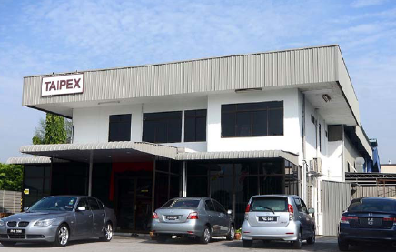
TAIPEX (M) SDN BHD
P1 : Injection Mold Facility
P2 : Warehouse, Senawang

Slide 12
Production Floor (Injection Mold)
TAIPEX (M) SDN BHD

Slide 13

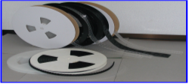

TaiPex Product Lines
Injection Molded
Reels, End Pins, Caps, Molded Parts etc
Thermoforming
Carrier Tapes
Others
Cover Tapes (HSA & PSA)
TAIPEX (M) SDN BHD

Slide 14
Tape & Reel
Tape & Reel is a packaging media for surface mount integrated circuits and board level metal shields which include carrier tape, cover tape & molded reel.
TaiPex’s industry proven products include carrier tape, cover tape and reels that addresses the users concerns for static control and stability, and allow for automated handling and placement of components to meet their high performance requirements.
TaiPex’s unique manufacturing capabilities -- which combine proprietary automated high-speed pocket embossing and hole punching equipment with precision dies and in-line vision system for the very versatile yet sensitive carrier tape. This assures consistent sealing quality with maximum physical and ESD protection.
TaiPex offer premium performance carrier tape, cover tape and plastic reel at competitive prices and strong technical, design (AutoCAD Chip Fit Analysis) & engineering support.
TAIPEX (M) SDN BHD

Slide 15
Tape & Reel
Carrier Tape (Bottom Tape) :
+ Provides device protection for fine-pitch packages and improved
throughput.
+ pockets with bottom pedestals / fences and high strength side walls
+ Class 6 tri-layer static dissipative styrenic material
+ AutoCAD Chip Fit Analysis capability to ensure best component
protection
+ Fast response prototype capability with our in-house tooling
workshop & design
TAIPEX (M) SDN BHD

Slide 16
Tape & Reel
Cover Tape (Top Tape) :
+ Static Dissipative
+ Heat sealable & durable (tear resistant) transparent (<10% haze
factor) polyester material
+ Excellent long term aging test results at hot (60 deg C), cold (-18
deg C) and room temperature
+ Low peel force variation – better Cpk control
TAIPEX (M) SDN BHD

Slide 17
Tape & Reel
Molded Reels :
+ Static Dissipative
+ Meeting EIA & EIAJ Standards
+ 7” and 13” formats in widths ranging from 8mm to 56mm
+ High Impact Polystyrene material
+ In compliance to Heavy Metal Standards
+ Anti-collapse design with fortified knit-lines – available on certain
options / design
+ Ultrasonic Welding capabilities with male-female locking option
available
TAIPEX (M) SDN BHD

Slide 18
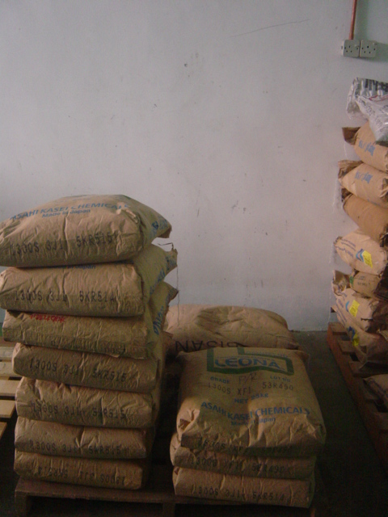
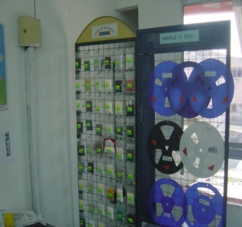
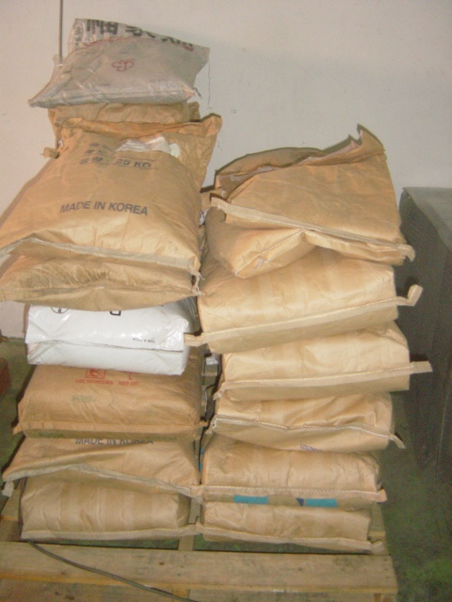
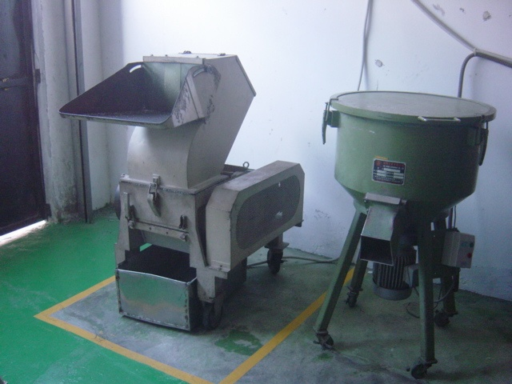
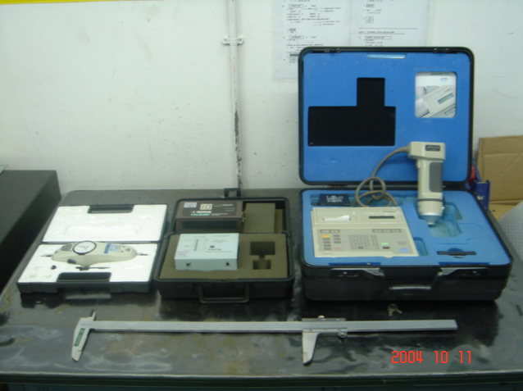
INCOMING PROCESS FLOW – INJECTION MOLDED REEL
IQA
INCOMING MATERIAL AWAITING IQA BUYOFF
MIXED MATERIAL READY FOR PROD. USE
GRINDING / MIXING
TAIPEX (M) SDN BHD

Slide 19
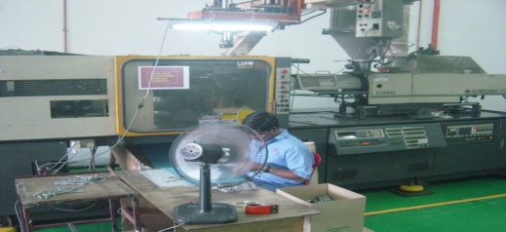
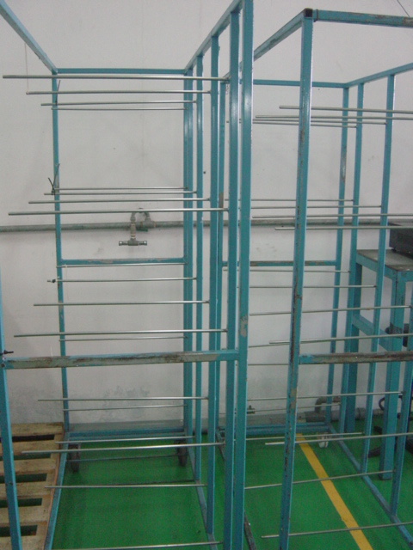
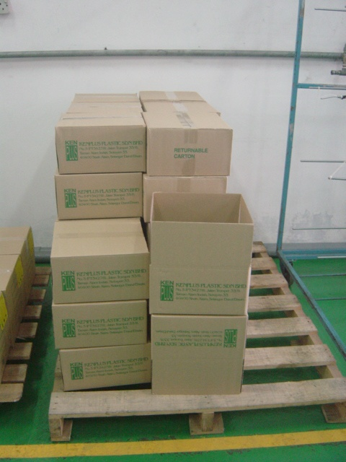
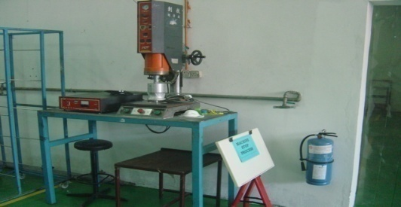
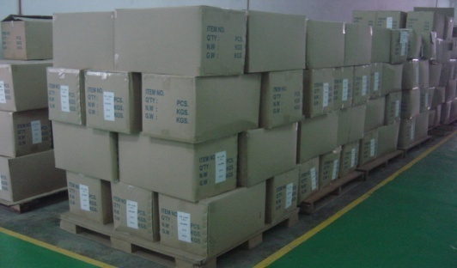

MANUFACTURING PROCESS FLOW – INJECTION MOLDED REEL
INJECTION MOLDING PROCESS
DIPPING / DRYING (ESD)
PACKING (AWAITING OQA BUYOFF)
ULTRASONIC WELDING (Assembly)
OQA
FGI
TAIPEX (M) SDN BHD

Slide 20
Key Customers
Broadcom Inc Avago Technologies
Inari Amertron Inc Arrow Components
Integrated Device Technology TPC (M) Sdn Bhd
ASE Philips Lumileds
Sanyo Semiconductor ON Semiconductor
Nissei Technologies Carsem Semiconductor
TAIPEX (M) SDN BHD

Slide 21
Future Plan
Set-up JV (Joint Venture) Manufacturing Plants /
Warehouse in South Malaysia, Philippines and China.
Attain Economies of Scale to leverage and bring down
production cost.
To become a ONE STOP SHOP for customers’ Packaging
Solution.
TAIPEX (M) SDN BHD

Slide 22
Business Enquiry
For further enquiries, kindly contact the following :
TaiPex (M) Sdn Bhd
Plot 71, Lintang Kampung Jawa,
Bayan Lepas Industrial Estate,
11900 Penang, Malaysia
Contact person : Benson Goh
Tel : 6-04-6302916 / 17 Fax : 6-04-6302918
Mobile : 6-016-443 3916
Email : benson@taipex.com.my
Website : www.taipex.com.my

Slide 24
Thank You.
TAIPEX (M) SDN BHD

